Slide 1
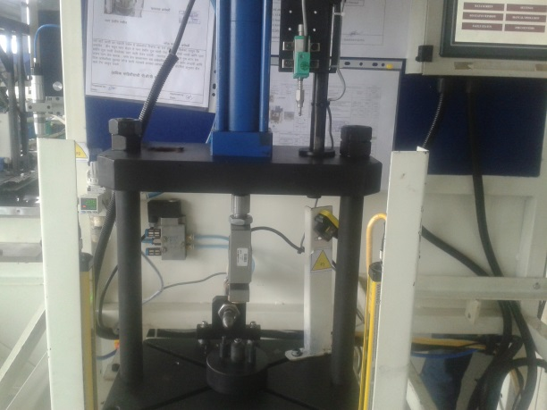
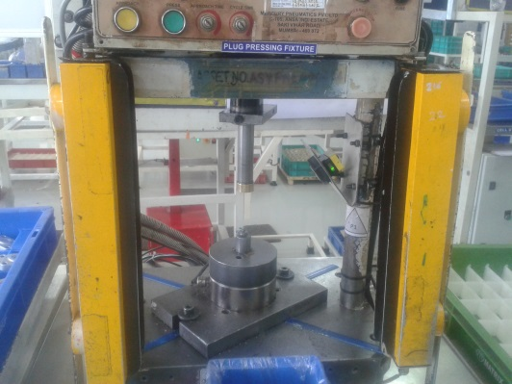
P15
TPM CIRCLE NO :- 3
ACTIVITY
KK
QM
PM
JH
SHE
OT
DM
E&T
KAIZEN IDEA SHEET
TPM CIRCLE NAME : P15 TEAM
LOSS NO. / STEP
DEPT :- Assembly
RESULT AREA
P
Q
DEF :- A
C
D
S
M
CELL :-A360
CELL NAME:- Tensioner
MACHINE / STAGE :- A360Assembly Line
OPERATION :- Plug Pressing
KAIZEN THEME : To avoid may happen customer complaint of plug half pressing in tensioner body
IDEA :- To implement LVDT type pressing to detect the length of plug pressing.
COUNTERMEASURE:- LVDT type plug pressing implemented.
BENCHMARK
0 No.
WIDELY/DEEPLY:-
TARGET
0 No.
KAIZEN START
10.08.2016
PROBLEM / PRESENT STATUS :- Current operation not able to defect plug pressing length.(req.2mm )
KAIZEN FINISH
25.09.2016
TEAM MEMBERS :-
NEHA MANKAR ,MADHURI THIGLE
PRAMOD KARDILE ,SAMADHAN .B
BENEFITS :-
Prevent Occurrence of Customer Complaint.
Reduce COPQ.
KAIZEN SUSTENANCE
BEFORE
AFTER
WHAT TO DO: Add Checkpoint in FGCP
HOW TO DO: Verify each tray of packing by QA inspector
FREQUENCY : 100 %
WHY - WHY ANALYSIS :-
Why1: Chances of may happen complaint of plug pressing not ok
Why 2: Current process not able to detect the pressing length
Why 3: No provision in current process.
RESULT :-
COST INCURRED FOR MAKING KAIZEN
MATERIAL COST
IN RS
LABOUR COST
IN RS
TOTAL COST
IN RS
ROOT CAUSE :-No provision in current process to detect pressing length of plug.
------------
-------
---------
SCOPE & PLAN FOR HORIZONTAL DEPLOYMENT
REGISTRATION NO. & DATE: 25.07.16
SR.
NO.
CELL
TARGET
RESPONSIBILITY
STATUS
REGISTERED BY :-Neha mankar
-A319/128--
----
-------
------
------
MANAGER’S SIGN :- Anil Shende

